Slide 1
Level 4/5 Group 18
Nomi-No-Sakune
Blake Hewitt, Elliot Dewhurst & Guy Zawada

Slide 2
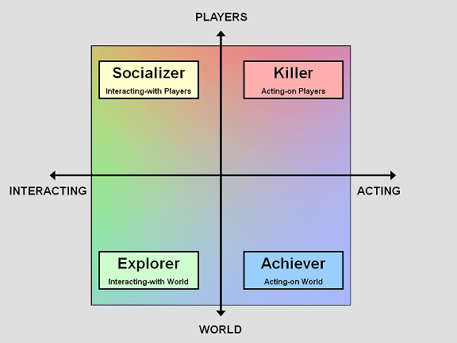
What’s Our Idea?
Genre: Physics-Based, 2D, Sumo style, 1 on 1 arena game
Platform: Desktop PC
Objective: Push your opponent off the arena
Target Demographic: Males aged 14+, Aimed at the ‘Killer’ player type
Reference Image: http://www.gamasutra.com/view/feature/6474/personality_and_play_styles_a_.php?print=1

Slide 3
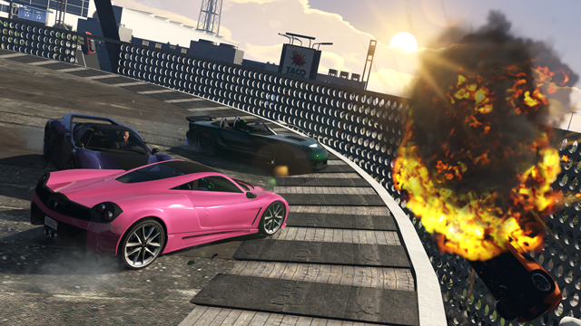
Inspirations for the idea
Sumo Cars – GTA V Multiplayer Minigame

Slide 4
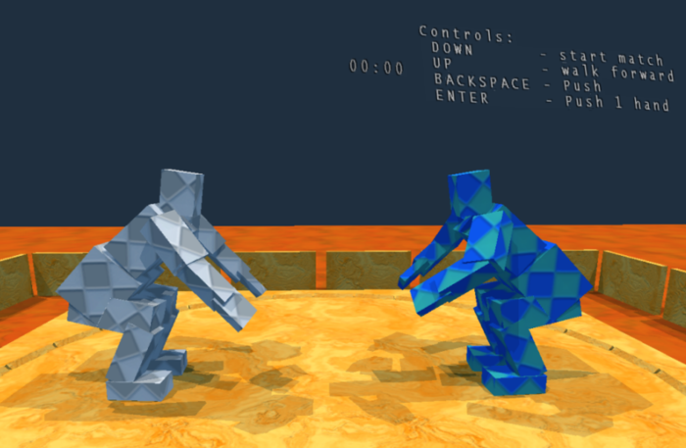
Inspirations for the idea
Sumotori
http://www.gravitysensation.com/sumotori/

Slide 5

Gameplay Demo
https://www.youtube.com/watch?v=KkRlkuIMCEk

Slide 6
Mechanics
Physics-based pushing
Boost Mechanic
Avoidance of opponent and obstacles
Awareness of round timer

Slide 7
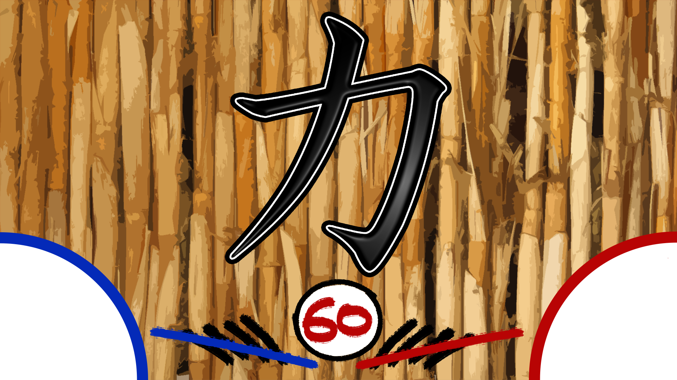
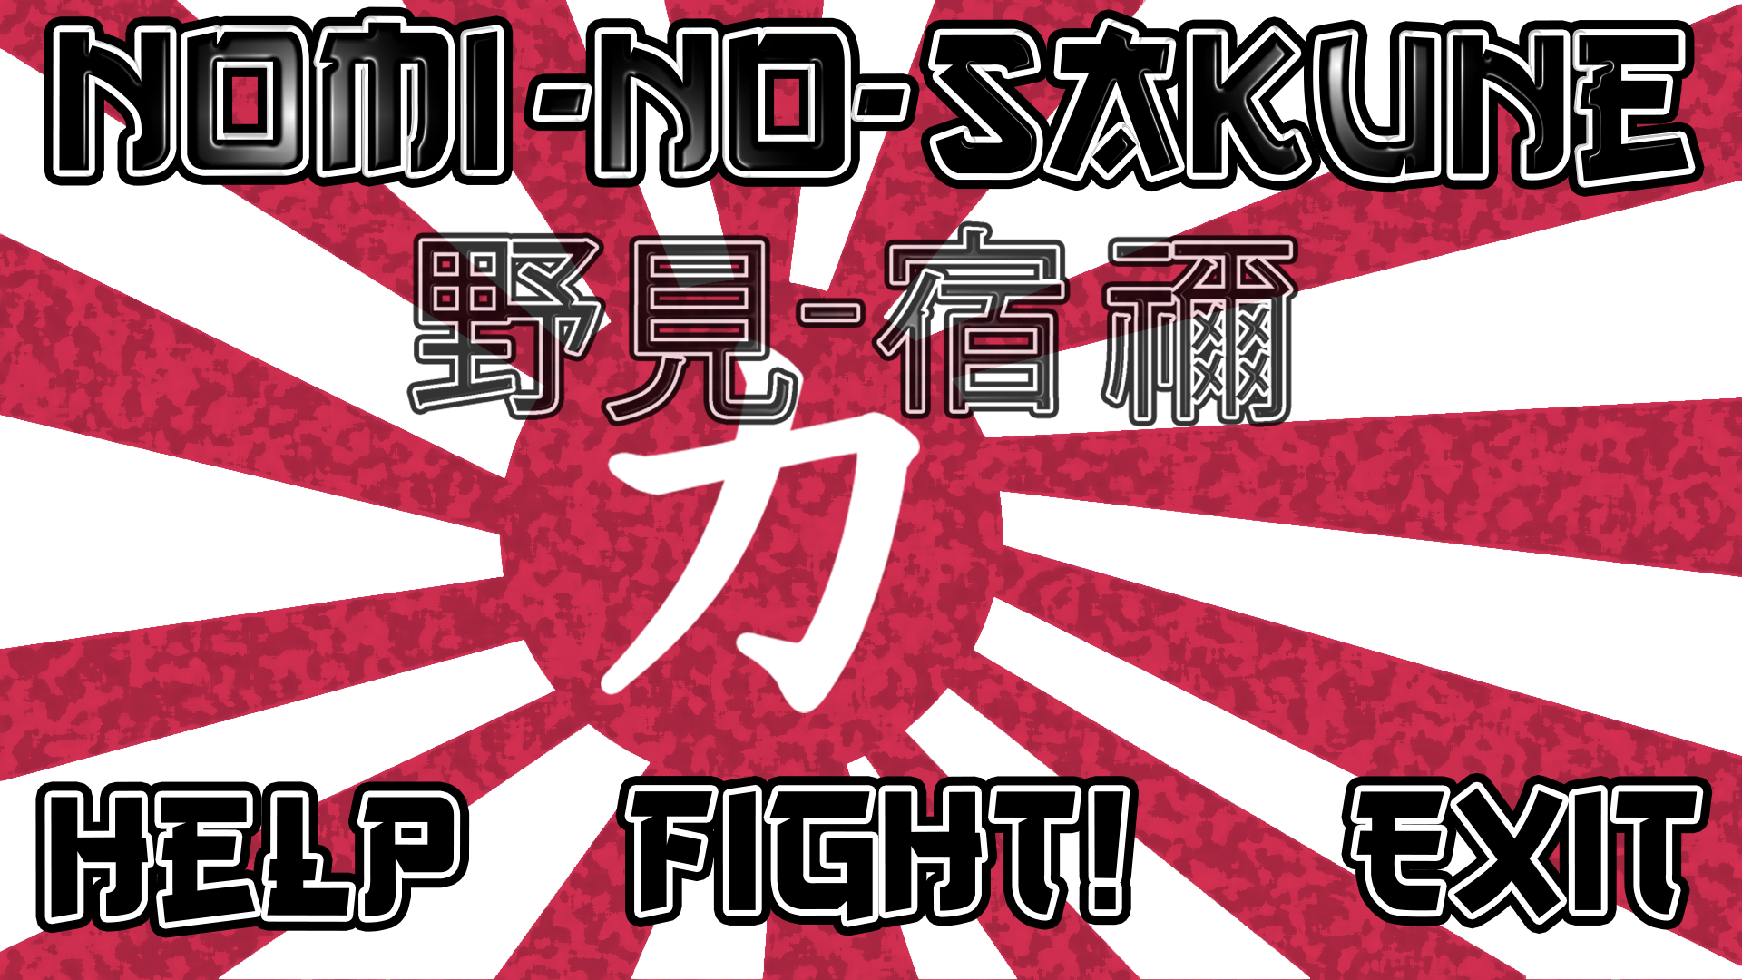
Design
Japanese Mountain Inspired theme
Quick-fire Rounds, multiple rounds per match
Strategic, risk and reward based power-up placement

Slide 8

Level Design
Based on Mount Fuji
One Powerup – Increased Speed
Icy areas in map to add randomness and unpredictability to movement
Pillars for player safety

Slide 9





UI
Iteration

Slide 10
Playtest Feedback Overview
On Average, people said the theme ‘Kind of worked with the rest of the game’
Some people said the camera stopped them seeing where power-ups were, some said the opposite.
Everyone said they enjoyed game
Everyone said the speed was perfect

Slide 11
Future/Stretch Goals
Based on playtesting feedback, in order of importance…
Visual Tutorial – Without Text
Adding theme consistency
Speed Powerup Tuning
Holes in the level to make rounds shorter lived
Particle Effects on Collision

Slide 12
Questions?

